Slide 1


Opportunity & Lead | Salesforce
Date:- 13th Nov 2022
Data Analyst
Project No. : P67
Group No : 04
Group Members
Anjali Kale
Gauri Agharkar
Aboli Hagone
Mayuri Yedave
Rohit Banate
Akshay Maskar
Yashraj Dalwe
Mentor:- Mr. Mahendra Singh

Slide 2
Project Objective
This Opportunity & Lead dashboard creation project is under the domain of Salesforce where we complied 2 datasets (Opportunity_table & Lead) with .csv extension files having different fields and the objective is to analyze the lead and conversion of opportunity.
Here we have showed different KPI’s→ Cards & Visuals using
Tableau & PowerBI - To showcase different views and corresponding dashboard.

Slide 3
Contents
Expected Amount
Active Opportunities
Conversion Rate
Win Rate
Loss Rate
Trend Analysis
Running Total Expected Vs Commit Forecast Amount over Time
Running Total Active Vs Total Opportunities over Time
Closed Won Vs Total Opportunities over Time
Closed Won vs Total Closed over Time
Expected Amount by Opportunity Type
Opportunities by Industry
Opportunity
Cards
Visuals

Slide 4
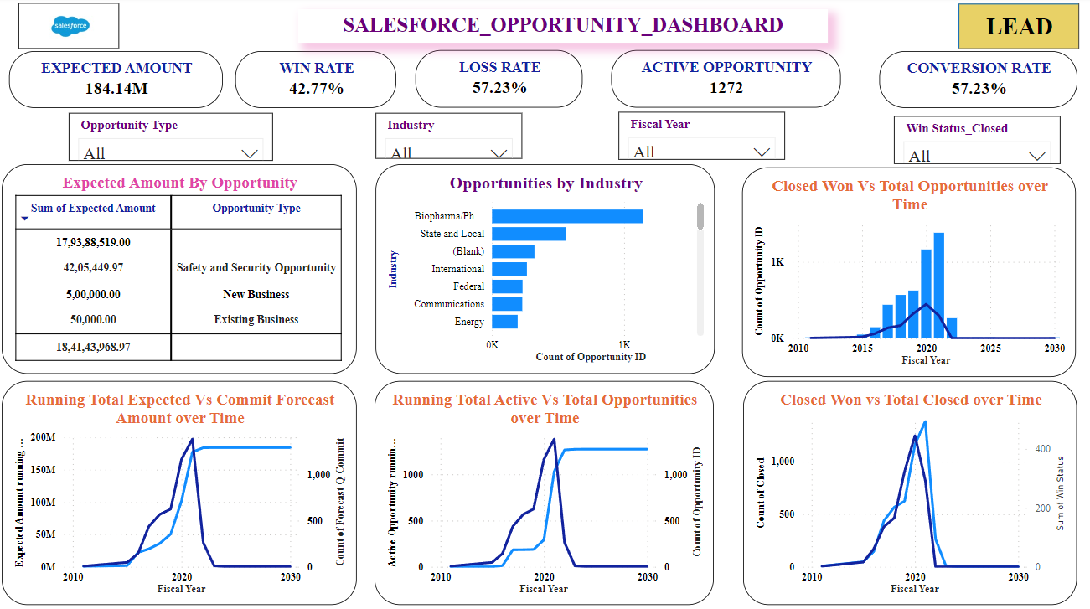

Slide 5
Contents
Lead
Total Lead
Expected Amount from Converted Leads
Conversion Rate
Converted Accounts
Converted Opportunities
Lead By Source
Lead By industry
Cal. Field
Visuals

Slide 6
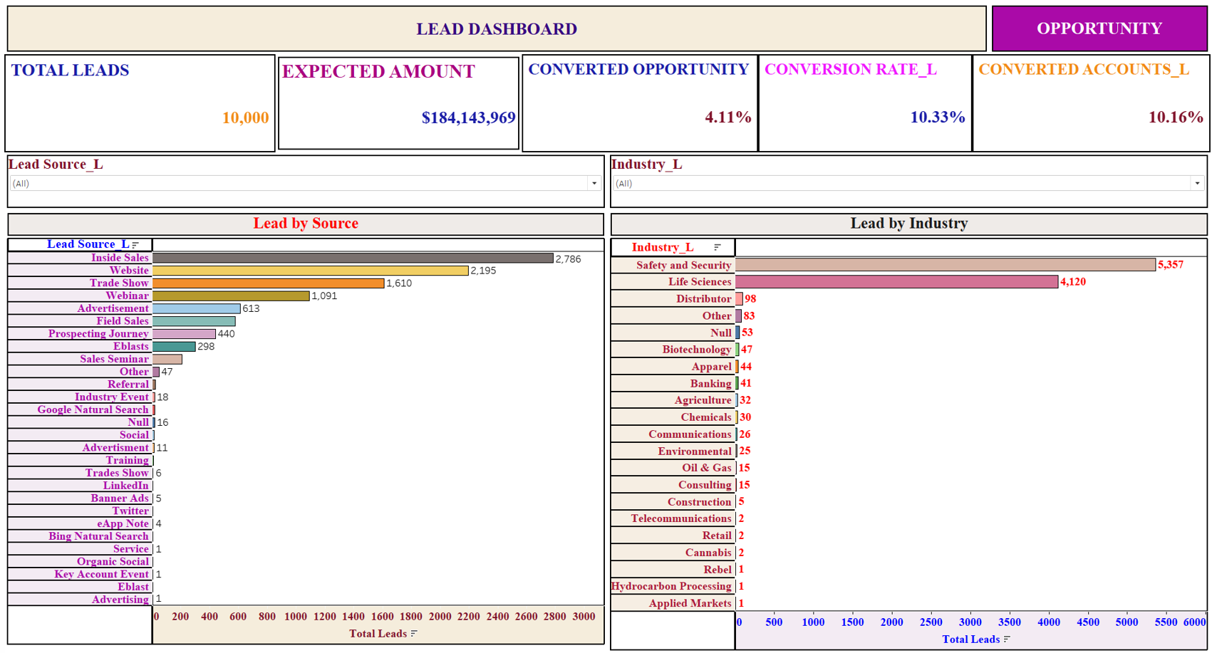

Slide 7
THANK YOU

